Slide 1
AI Video Trimmer
Class X AI Project
Submitted by: Arnav Gupta
Submitted to: Ms. Deepti Sharma

Slide 2
Acknowledgement
I am grateful to my teachers and mentors for their encouragement.
I would like to express my sincere gratitude to everything who contributed to the successful development of this project, AI Video Cutter.
I would also like to acknowledge the developers and communities behind the open-source tools and technologies used in this project, whose work made its implementation possible.
Finally, I would like to thank my family and everyone who supported me during the planning, development, testing, and refinement of this project.
This project has been a valuable learning experience, allowing me to explore software development, automation, artificial intelligence, and multimedia processing in greater depth.

Slide 3
Index (Table of Contents)
S. No. | Topic
1 | Title Slide
2 | Acknowledgement
3 | Index
4 | Inspiration
5 | Problem Statement
6 | Data Acquisition
7 | Data Exploration
8-10 | Modelling and Explanation
11 | Evaluation
12 | Deployment

Slide 4
Inspiration
At the time of ideation, I was working with one of my friends on a YouTube channel. I noticed that although recording a video took less than 30 minutes, more than an hour was often spent just trimming out the redundant parts.
This made me realise how time-consuming the editing process was and led me to explore ways to automate it.

Slide 5
Problem Statement
WHO | Content Creators, Video Editors, Automation Enthusiasts
WHAT | A significant amount of time is spent in rote trimming of redundant parts form the video.
WHERE | In social media firms, post processing of video clips
WHY | Manual editing is time-consuming and repetitive. Automating this process can reduce editing time and allow content creators to focus more on recording and creating content.

Slide 6
Data Acquisition
For developing the project, I collected video samples from different sources to understand and analyse real-world recording patterns.
Self-recorded videos: Videos recorded by us.
Online videos: Publicly available videos.
Test recordings: Specially recorded samples containing pauses, retakes, filler words and other common recording errors.
These videos provided me with the audio and speech data required for developing and testing the project.

Slide 7
Data Exploration
After collecting the videos, I analysed their audio and speech patterns to identify the portions that could be considered redundant during editing.
Long pauses: Unnecessary gaps between sentences.
Retakes: Repeated attempts at speaking the same sentence.
Filler words: Frequent use of words such as "um", “ah, “like” etc.
Unnecessary repetitions: Repeating words or phrases during recording.
This analysis helped me understand the different patterns in recorded speech and identify which portions could be targeted for deletion.

Slide 8
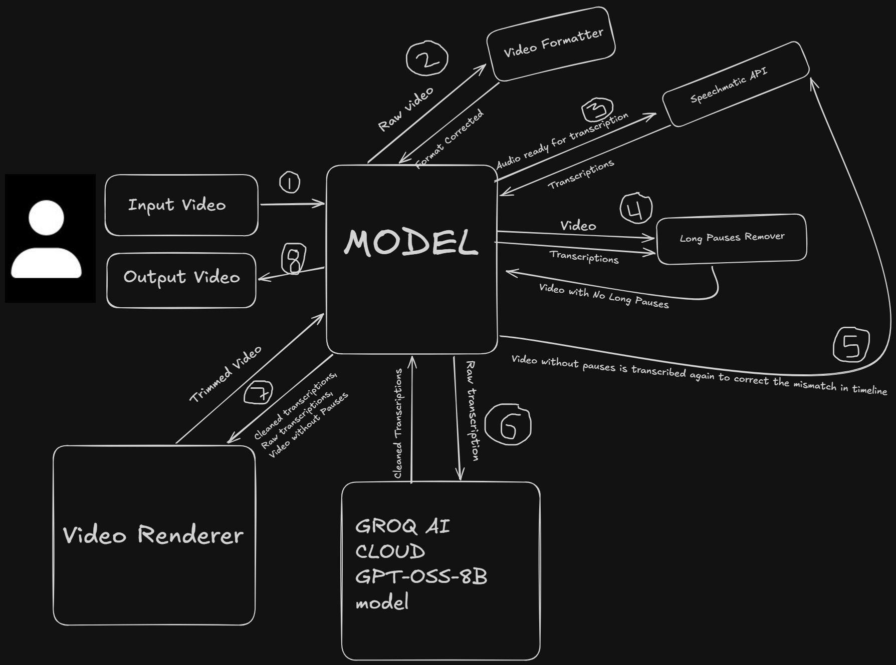
Modelling
Here is the System Architecture diagram of how we are solving this problem

Slide 9
Explanation
Input Video: The user uploads the raw video that needs to be processed. The video is then passed to the main model, which manages the entire processing pipeline.
Video Formatting: The raw video is sent to the Video Formatter, where it is converted into a compatible format(.wav). The formatted video is then returned to the main model for further processing.
Audio Transcription: The audio is extracted from the formatted video and sent to the Speechmatics API. The API converts the speech into text and generates word-level timestamps, which are returned to the main model.
Long Pauses Removal: The video and its corresponding transcriptions are sent to the Long Pauses Remover. It identifies long gaps between spoken words using their timestamps and removes those pauses from the video.
Re-transcription: Since removing pauses changes the video's timeline, the original timestamps no longer accurately represent the new video. Therefore, the video without long pauses is sent for transcription again to the Speechmatics API to generate updated timestamps.

Slide 10
Explanation
AI-based Transcription Cleaning: The raw transcriptions are sent to the GPT-OSS-8B model through Groq AI Cloud. The model identifies and cleans unnecessary transcription elements while retaining the relevant spoken content. The cleaned transcriptions are returned to the main model.
Video Rendering: The video without long pauses, along with the raw and cleaned transcriptions, is sent to the Video Renderer. It uses the cleaned transcriptions to identify the portions that need to be removed and renders the final edited video.
Output Video: The rendered video is returned to the main model, which provides the final processed video to the user.

Slide 11
Evaluation
Here is an Example of how did my model perform on a test video.
Input: Raw Transcription
"Hello everyone, so (long pause) today we are going to, uh, discuss artificial intelligence discuss artificial intelligence. Artificial intelligence is, is a technology that allows machines to perform (long pause) tasks that normally require human intelligence. So basically, um, it can be used in healthcare, education and many other fields. And, and I think that is, uh, what makes AI so interesting."
Output: AI-Cleaned Transcription
"Hello everyone, today we are going to discuss artificial intelligence. Artificial intelligence is a technology that allows machines to perform tasks that normally require human intelligence. It can be used in healthcare, education and many other fields. I think that is what makes AI so interesting."

Slide 12
Deployment
The project is hosted on a Github repository at https://github.com/arnav335/AiVideoCutter
You can find the necessary steps to run this on the homepage of this Github repository

Slide 13
THANK YOU

